Slide 1

New Trends in Energy Storage
Constantinos Taliotis
taliotis@kth.se
Introductory lecture – Energy commodities and technologies
This work by OpTIMUS.community is licensed under the Creative Commons Attribution 4.0 International License. To view a copy of this license, visit http://creativecommons.org/licenses/by/4.0/.
Notes:
Good afternoon and welcome to the lecture on “…”.
Introduce yourself and your research, field of expertise

Slide 2
Motivation for energy technology research and development
Notes:
To start with, it’s important to understand why efforts are put into improving the structure of the current energy system. For instance, even in Sweden where the share of renewables is very high in comparison with the rest of the world (or even EU), there are efforts to transform the energy system into completely carbon free in the next few decades. This is not trivial, considering the fact that the transport sector is heavily reliant on oil products.

Slide 3
Why innovate?
Energy Efficiency – Cost Efficiency
The cheapest kWh is a kWh not generated
Making the best out of the available resources
Energy Security
Resilient and robust energy system
Taking advantage of domestic energy sources leads to reduced reliance on fuel imports
Climate Change
Transition to low-carbon economy
Health and environment
Reduced emission of air and water pollutants that adversely affect health
Notes:
>Moving on, one important aspect to improve on is energy efficiency, which directly corresponds to a more cost-efficient system. In terms of electricity generation, the cheapest kWh is a kWh not generated – this can be achieved for instance with better thermal insulation, thus reducing the need for heating or cooling.
>Furthermore, technology improvements help in strengthening the resilience and robustness of the energy system, as for example it can withstand outages more effectively. In addition, by maximizing the use of domestic energy sources, import dependency is reduced and disruptions in fuel supply and price fluctuations are avoided. For instance, EV owners charging their vehicles with electricity from domestic solar and wind technologies, remain unaffected in the case of sudden surges in oil price.
>In addition, future deployment of technologies that help reduce CO2 emissions is significant. Finally, emissions of air and water pollutants that adversely affect health public health and the environment can be reduced.
All of these aspects are connected to each of the technology options we will discuss today

Slide 4
Storage
Notes:
Smart grids require the integration and operation of certain technology options. This includes energy storage

Slide 5
Storage – forms of storage
Energy can be stored in many forms and several media. Key examples include:
Pumped-hydro storage >> gravitational
Flywheels >> mechanical/rotational
Solid state batteries (e.g. Li-ion batteries) >> electrochemical
Compressed Air Energy Storage (CAES)
Thermal energy storage – e.g. hot water
Notes:
Energy can be stored in a variety of forms and media. Examples include (explain in relevant detail)

Slide 6
Maturity of energy storage technologies
Notes:
Despite the fact that there is a large array of storage technologies, their maturity varies. In this figure we have the maturity level (R&D, demonstration and deployment or commercialization) on the x-axis and a combination between capital cost and risk on the y-axis.
Pumped storage is one of the oldest methods of storing electrical energy.
Residential hot water heaters store energy in the form of heat.
Li-ion batteries currently undergoing fast improvements in cost (they are also highly efficient)
Hydrogen still very expensive

Slide 7
Storage – Benefits
improving energy system resource use efficiency
increasing use of variable renewable resources
rising self-production and self-consumption of energy (electricity, heat/cold)
increasing energy access (e.g. via off-grid electrification using solar photovoltaic (PV) technologies)
facilitating in electricity grid stability, reliability and resilience
increasing end-use sector electrification (e.g. electrification of transport sector).
Notes:
Deployment of storage in the system can offer multiple benefits. First of all, energy resources already existing in the system can be used more efficiently, while the share of vRET can also be increased. (Draw load curve and explain the first two).
By installing storage devices at the final end-use level (e.g. household, commercial, industrial), self-production and –consumption of energy increases. For instance, electricity from solar PV or hot water from solar water heaters can be stored and used at the time of demand.
Increasing energy access- important in rural villages in SSA for instance.
Storage helps with the establishment of a reliable, stable, resilient grid. In case of sudden events storage can act as backup (operational reserve) – contributes to reserve margin.
As you know, batteries are necessary for EV deployment and the electrification of the transport sector.

Slide 8
Storage applications
Seasonal storage
Energy arbitrage and peak demand shifting
Ancillary services
Black start
Grid congestion relief
Off-grid energy demand
Source: IEA, 2014 . Energy Storage
Notes:
Storage can be used for a variety of applications. (explain some of them)
In France, more than one-third of households use electrical water heaters equipped with a “2-period meter,” which allows these water heaters to be used as distributed thermal storage resources (Enerdata, 2011; EIA, 2013). These meters also allow customers to respond to the country’s peak-pricing structures, which were first implemented in the 1960s. In 2013, EDF quoted off-peak electricity prices at EUR 100/MWh versus EUR 130/MWh for peak electricity. This reduction was achieved in part thanks to consumer information campaigns on electricity pricing structures (peak versus offpeak pricing) and a remote start/stop function option that allows grid operators to remotely control these water heaters. As a result of this peak reduction, French utilities claim that thermal energy storage has helped the country optimise its use of the nation’s generation capacity. At the same time, it has helped France reduce its energy-related CO2 emissions by limiting the use of expensive fossil fuel-fired peak generation plants (Hercberg, 2013).

Slide 9
Storage deployment options for electricity
Source: IEA, 2014 . Energy Storage
Notes:
>You can have storage at different levels in the system. At the supply side and on the T&D level, storage requires centralized planning, but consumers may decide to deploy options at the final end-use level.
>With smart grids, potentially a service provider may take up the role of adding storage on the demand-side.
>Vehicle-to-grid

Slide 10
Variable renewables and storage
IEA ETP 2DS scenario – 80% chance to limit global temperature increase to 2ºC
Storage capacity in 2050
Source: IEA, 2014 . Energy Storage
Notes:
In the IEA ETP 2DS scenario, which assumes an 80% chance to limit global temperature increase to 2oC, the RE share in electricity generation increases in different regions of the world as seen in the top figure. By 2050, the EU reaches about 45%, China and the US 35% and India exceeds 25%.
To achieve these shares in 2050, the level of storage deployment is shown in the figure below for each region (light green bar as opposed to the dark green which corresponds to 2050).
Breakthrough – In a "breakthrough" scenario, with aggressive cost reductions in storage technologies (blue bar), the level of storage increases due to higher cost-competitiveness.
EV scenario - In an "EV" scenario, where demand response from "smart" charging of the electric vehicle fleet in the 2DS provides additional flexibility to the system, thus reducing the required level for storage to achieve a 2DS. – In this case it’s good to note the need for smart-grids operation to allow such charging scheme.
Current installed generation capacity (US-1000 GW), Germany (150 GW), France and Italy (125 MW)

Slide 11
Share of renewables vs storage capacity in the United States in 2050
Source: IEA, 2014 . Energy Storage
Notes:
Here we can see the effect of different shares of RE on a national electricity system (that of the USA). Both figures show results for 2050. The top figure shows the generation mix for different targets of RE share in electricity generation. The bottom figure shows the total installed capacity of the respective technologies, with the purple-greyish color indicating required storage capacity. The higher the RE share the higher the need for storage, as RE don’t always produce at the same time as electricity is demanded. This comes at a cost.
Connection to next slide: However, already in some countries storage enables consumers to achieve lower electricity prices

Slide 12
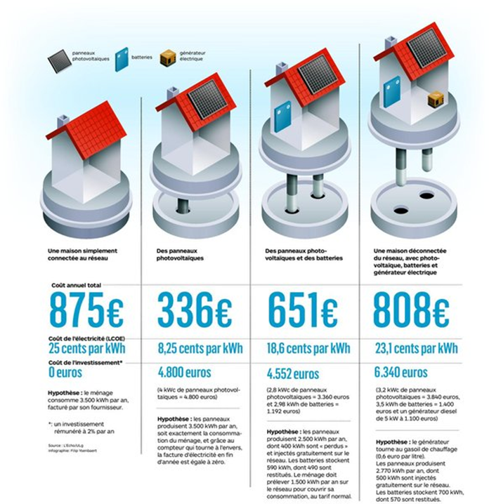
Electricity cost in Belgium and the potential for off-grid generation
Source: www.lecho.be
Notes:
Distributed RE + Storage
Same reliability level possible
E.g., small hydro: black-start capable
Germany: loans/subsidies for PV storage
Distribution of costs for grid access requires consideration
The advantages to society are twofold. The system would increase the supply security of the connected households in the case of outages. Further, the system reduces the pressure on local grids by reducing the peak production of the PV systems.
No need to pay for electricity tax +
You don’t contribute to grid costs -

Slide 13
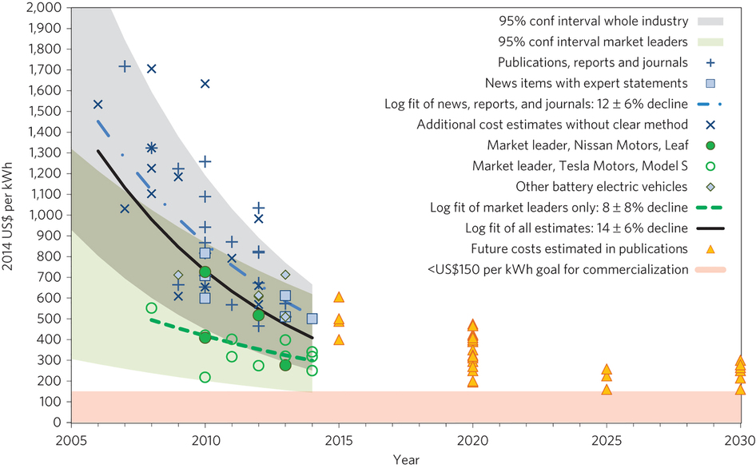
Cost of Li-ion battery packs in BEV
Source: Nykvist & Nilsson, 2015
Notes:
Since currently the biggest obstacle for storage deployment, is the upfront cost, it is important to look into what the trends are and what projections are estimating. In the case of Li-ion batteries for BEV, the cost has decreased rapidly and is expected to continue to decrease, as R&D continues. Already market leaders such as Tesla and Nissan have achieved prices that have been projected to come in the next 10-15 years.

Slide 14
Suggested further reading
IEA Technology Roadmap: Energy Storage
http://www.oecd-ilibrary.org/energy/energy-storage_9789264211872-en

Slide 15
Changelog and attribution
Date | Author | Reviewer | Reviser
2017-10-10 | Constantinos Taliotis | Agnese Beltramo | Constantinos Taliotis
To correctly reference this work, please use the following:
Taliotis, C., 2017. New Trends in Energy – Storage, OpTIMUS.community. Available at: http://www.osemosys.org/understanding-the-energy-system.html. [Access date]

